Slide 1
REAL TIME SIGN LANGUAGE INTERPRETER

Slide 2


SUPERVISED BY:
PRESENTED BY:
Khaled Medhat Mahmoud Mohammed Sayed Awwad Mahmoud Morad Youssef Mohamed Magdy Mostafa Yomna Hussein Mohamed
Dr. Haytham Azmi

Slide 3
TABLE OF CONTENTS
01
INTRODUCTION
RELATED WORK
02
03
DATASET
METHODOLOGY
04
05
WEB APPLICATION
06
RESULTS & COMPARISONS
07
CONCLUSION

Slide 4
01 INTRODUCTION

Slide 5


INTRODUCTION
Why we chose this project
How to implement

Slide 6
02 RELATED WORK

Slide 7






RELATED WORK
ITALIAN SL
INDIAN SL
PORTUGUESE SL
AMERICAN SL
BRITISH SL

Slide 8
03 DATASET

Slide 9
The base dataset that we used is World Level American Sign Language (WLASL) from Kaggle

Slide 10



PROBLEMS WE FACED
It contains both static and dynamic signs
Some signs’ data are either missing or bad
Contains both videos and images

Slide 11
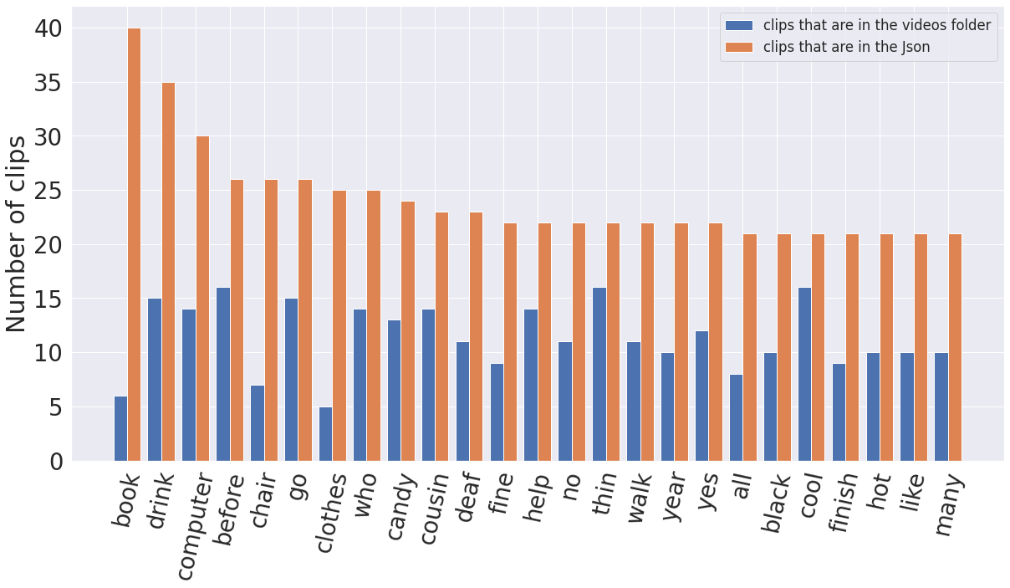
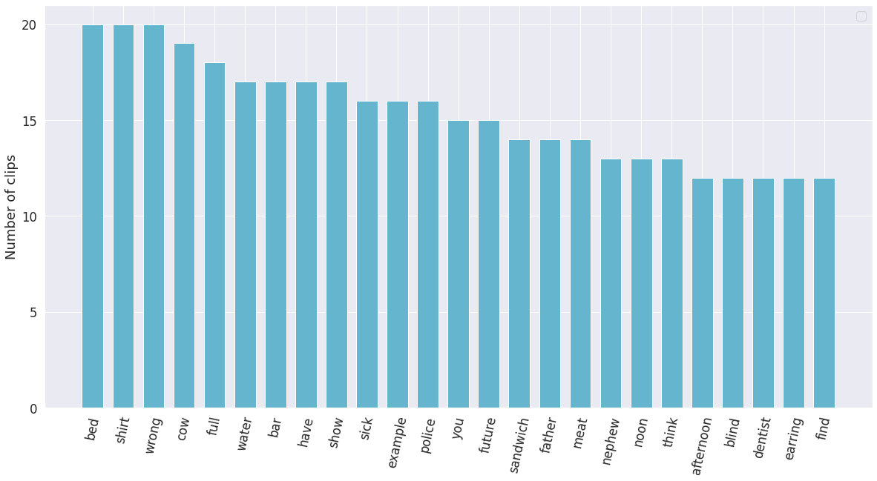
DATASET FIRST ITERATION
Top general 25 words
Top static 25 words

Slide 12
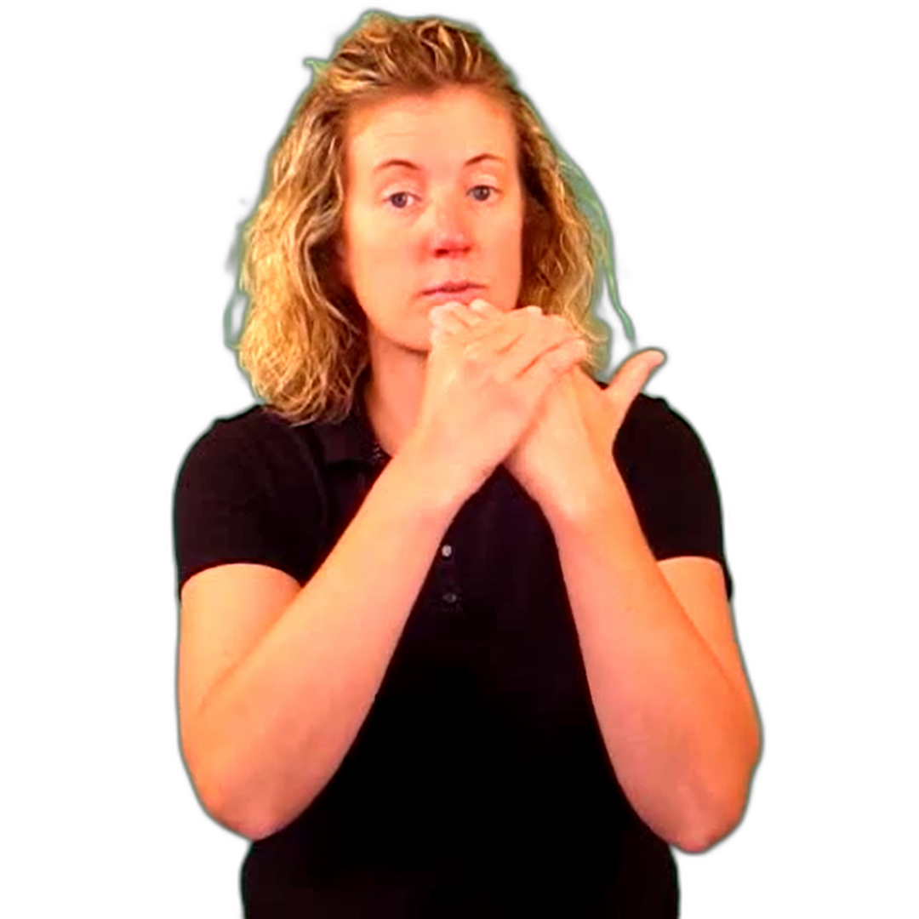
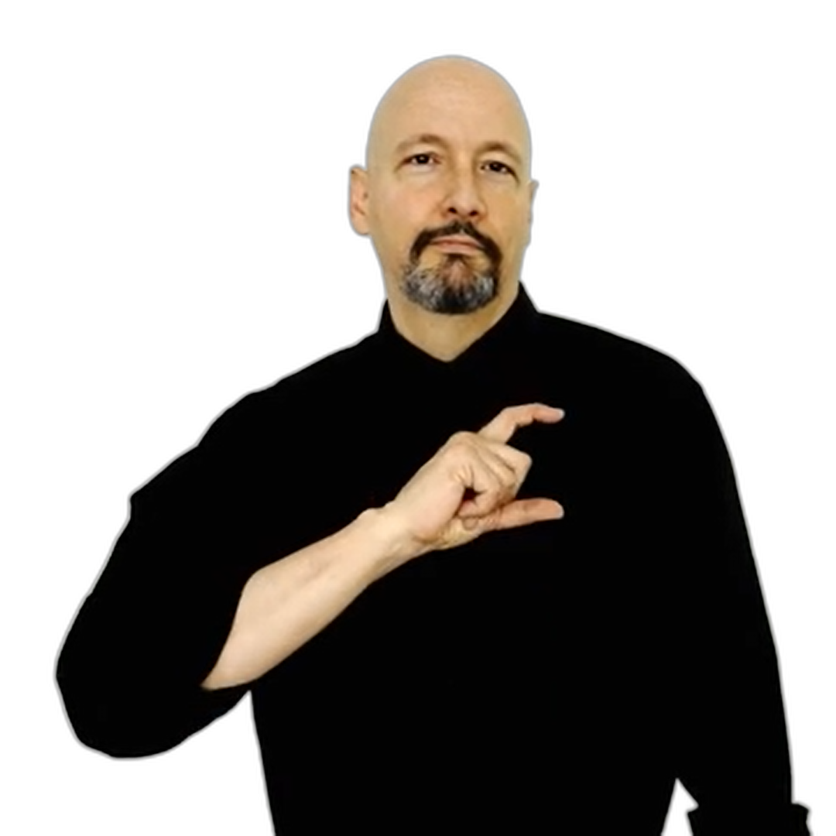
In the second iteration of the dataset was that we used YouTube and ASL Sign Bank to crop frames of the signed words in a 1080 x 1080 resolution, we removed the background for this iteration, but results was not good either
DATASET SECOND ITERATION

Slide 13
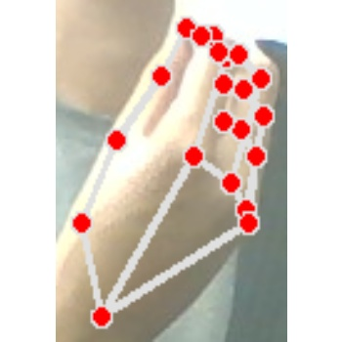
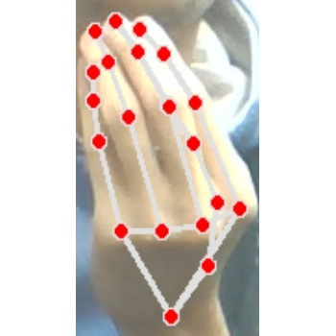
In the third and final iteration, we wanted to increase the dataset, so we took sample by ourselves and many people we ran by and focused only on the hand. The final dataset contained 15 words, each word consists of 60 training images and 20 validation images. All in a 350 x 350 resolution for uniform training.
DATASET THIRD ITERATION

Slide 14
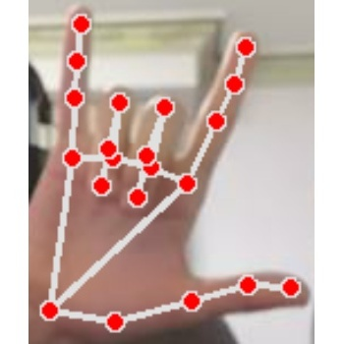
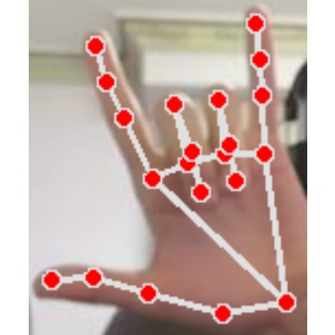
After finishing, we’d have gathered 40 images for each word. And to make the model more robust, and allow for both left and right-handed signs, we looped on all folders, and vertically flipped the images. After flipping, we ended up with 80 images for each word, which were then split into 60 training (30 normal and 30 flipped) and 20 validation (10 normal and 10 flipped) all of size 350 x 350.
Pre-processing and data augmentation

Slide 15















Yes
Police
Water
Wrong
Full
Shirt
I love you
Telephone
Have
Drink
Prefer
Hello
I
You
Food
Water

Slide 16
04 METHODOLOGY

Slide 17


METHODOLOGY
Data Acquisition
Prediction Process

Slide 18
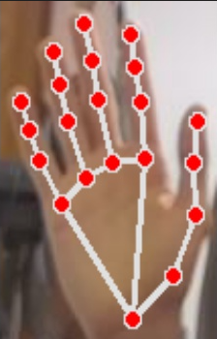




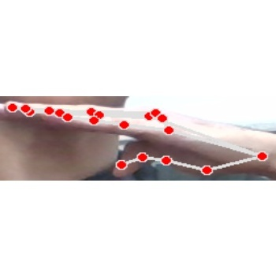
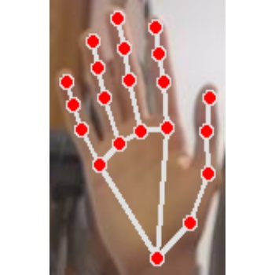




DATA ACQUISITION
01
02
03
04
Loop
Detect hand
Crop
Resize into box
08
07
06
05
Split
Flip
Save
Fill empty spaces

Slide 19



MODEL PREDICTION
01
02
03
04
Read frames
Detect hand
Crop
Resize into box
07
06
05
Display label
Predict
Fill empty spaces

Slide 20
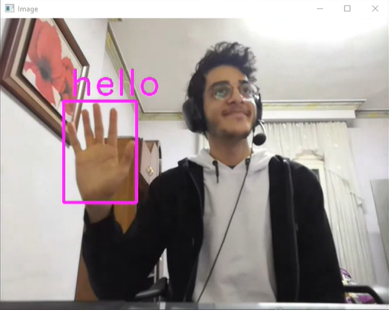
Model Prediction

Slide 21
05 RESULTS & COMPARISONS

Slide 22


RESULTS & COMPARISONS
Initial Version
Final Version

Slide 23
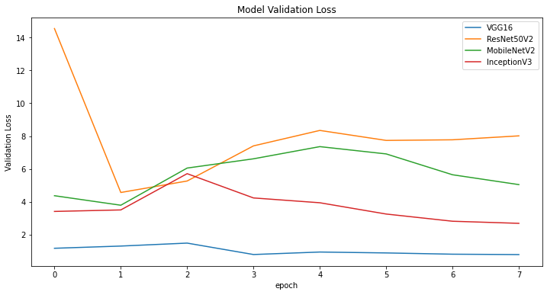
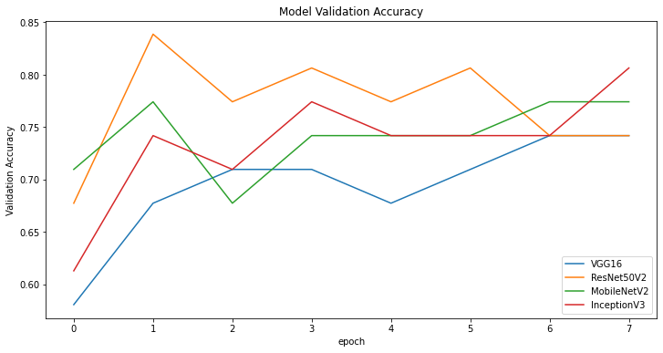
INITIAL VERSION
Training

Slide 24
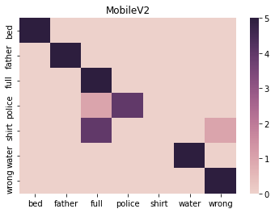
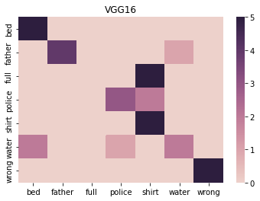
INITIAL VERSION
Testing

Slide 25
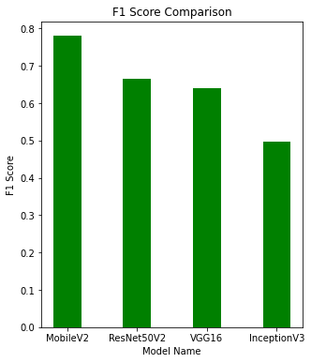
INITIAL VERSION
Testing

Slide 26
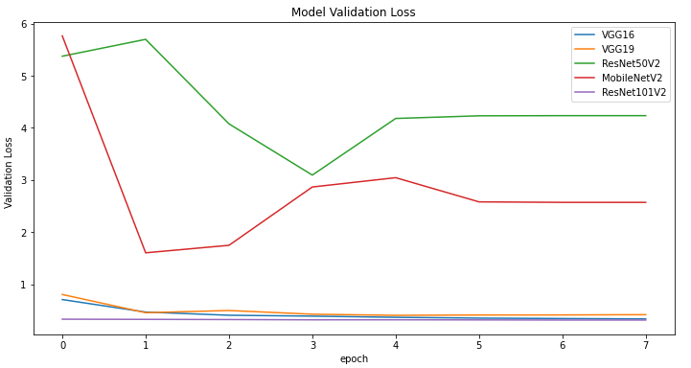
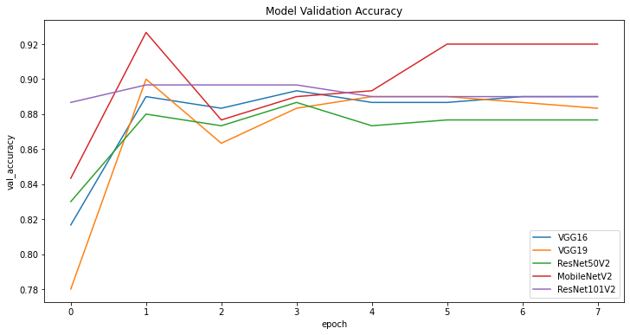
FINAL VERSION
Training

Slide 27
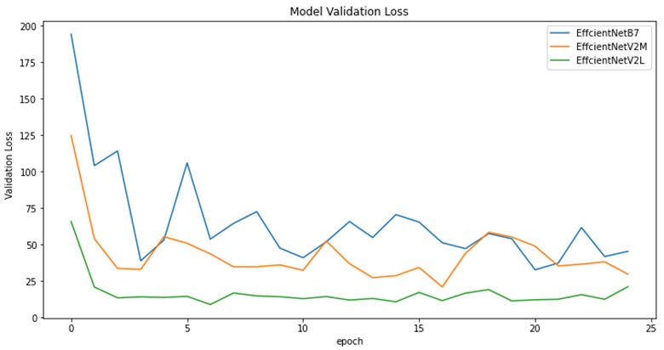
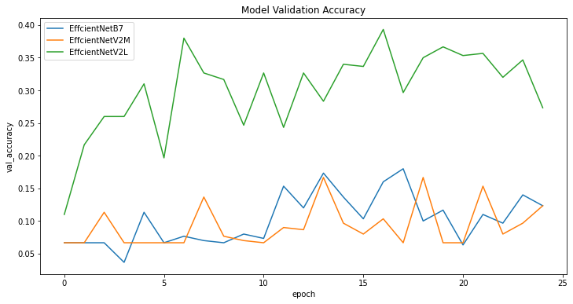
FINAL VERSION
Training

Slide 28
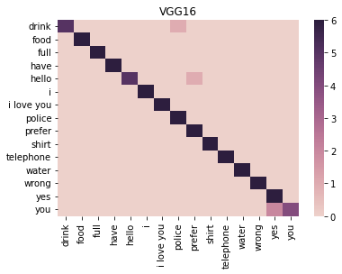
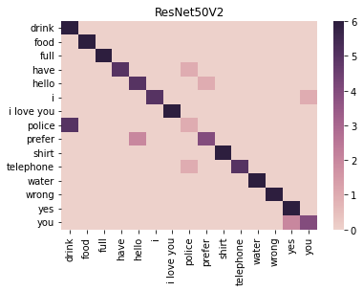
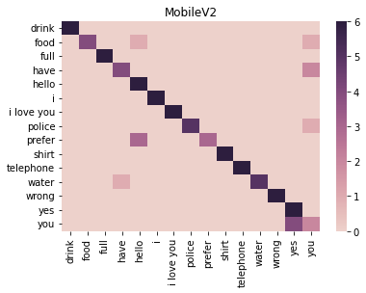
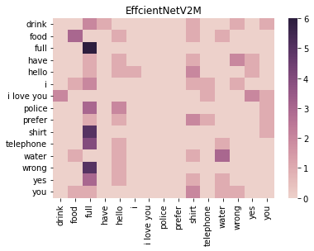
FINAL VERSION
Testing

Slide 29
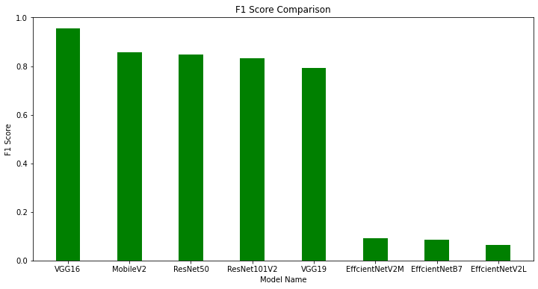
FINAL VERSION
Testing

Slide 30
COMPARISON
 | Italian SL | Portuguese SL | British SL | Indian SL | American SL | Our project
Model | CNN | SVM | SVM | Haar cascade classifier | K-NN and SVM | CNN
Dataset size | 11,008 | 4668 | 13,066 | 5250 | 7900 | 900
Dataset type | Letters | Letters | Letters | Words | Letters | Words
Accuracy | 99% | 99.6% | 99% | 92.68% | 98.7% | 96%

Slide 31
06 WEB APPLICATION

Slide 32





WEB APPLICATION

Slide 33
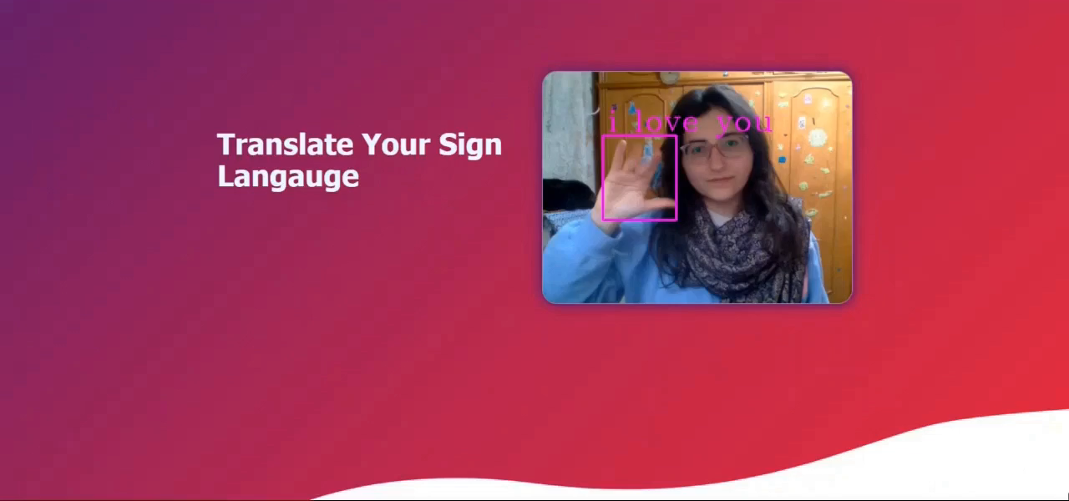

Slide 34



APPLICATION FUTURE SCALABILITY
Real-time video communication service
Supports multiple languages
Speech to text converter

Slide 35
07 CONCLUSION

Slide 36
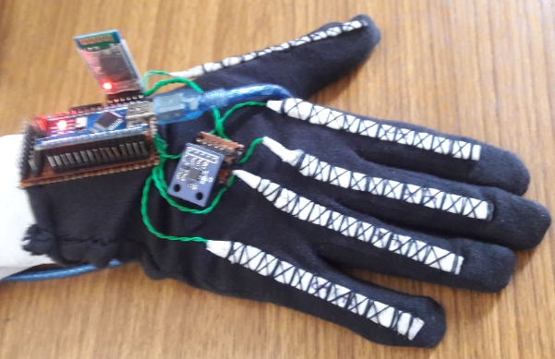
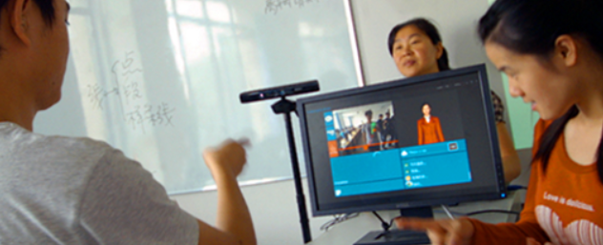
OTHER WORKS

Slide 37
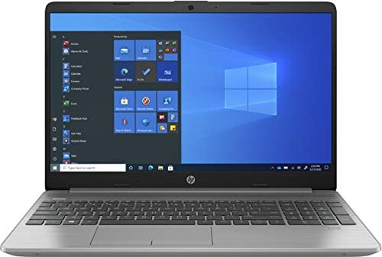
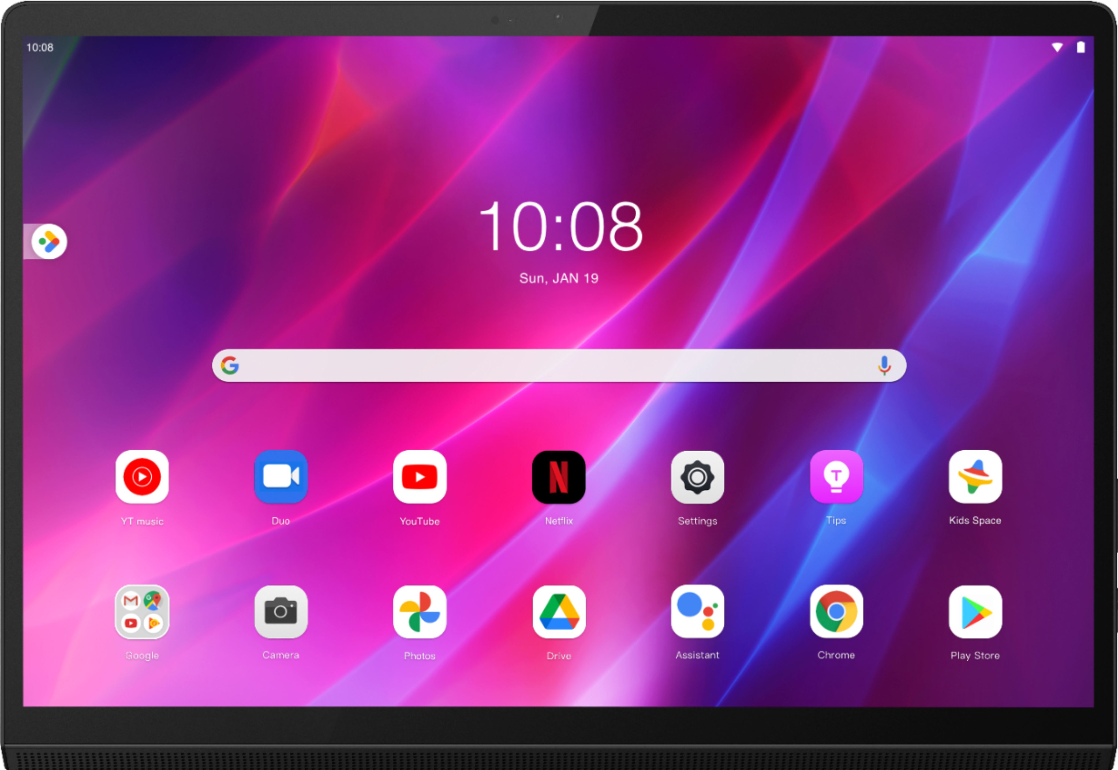
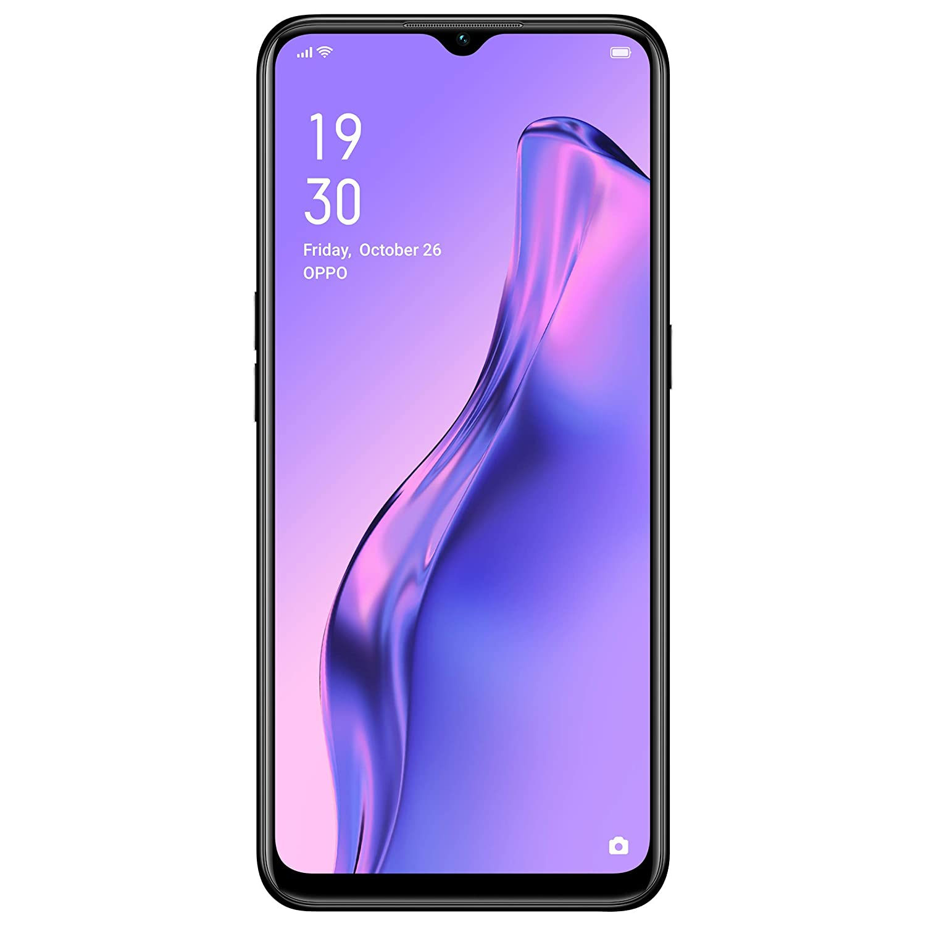
OUR SOLUTION

Slide 38

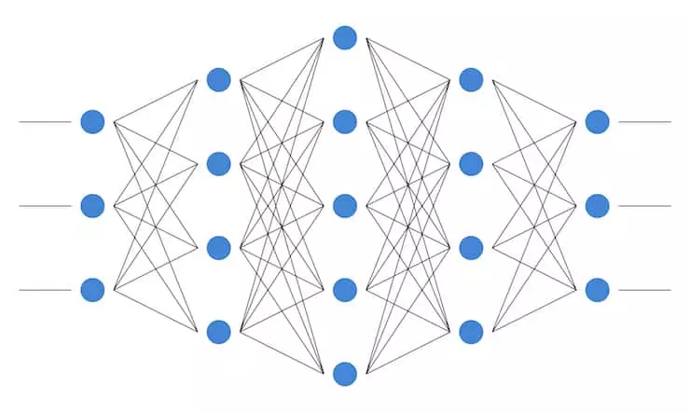
DATA ACQUISITION & MODEL TRAINING
Creating & collecting data
CNN & VGG16 model

Slide 39
THANK YOU

